Slide 1

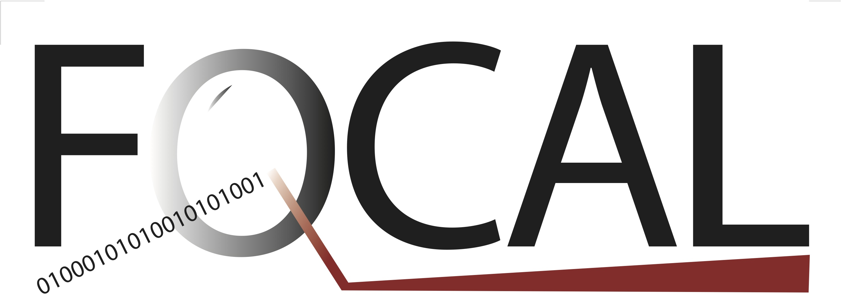
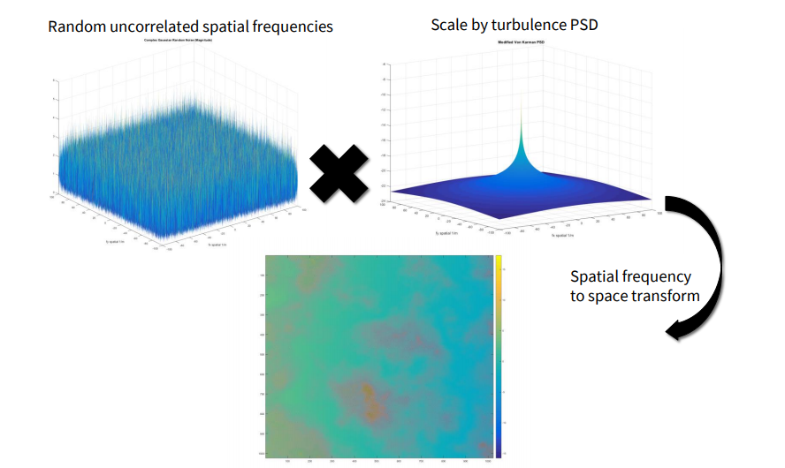
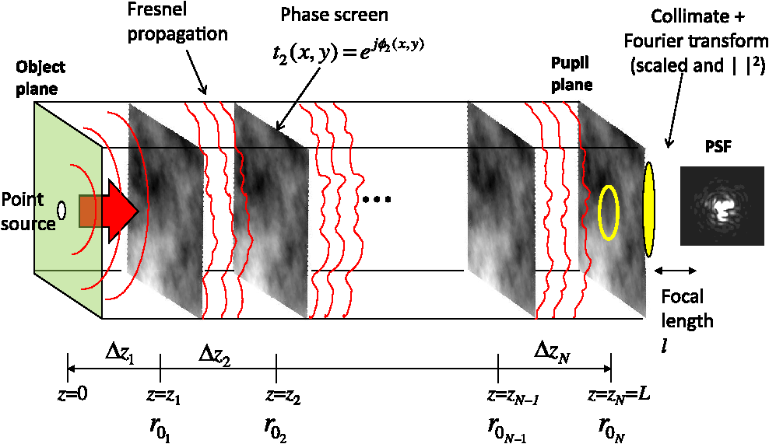
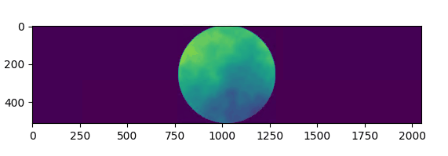
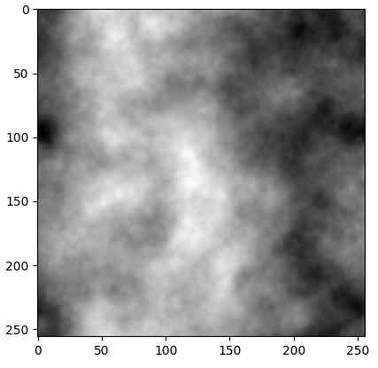
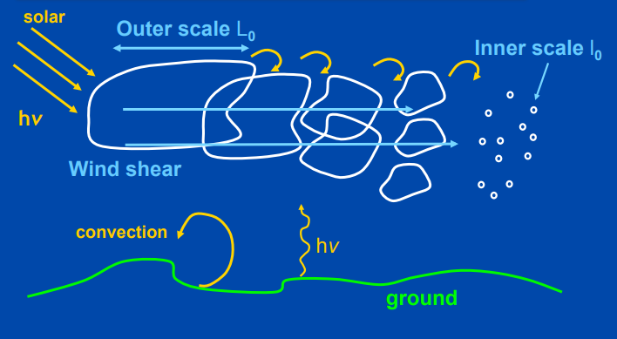
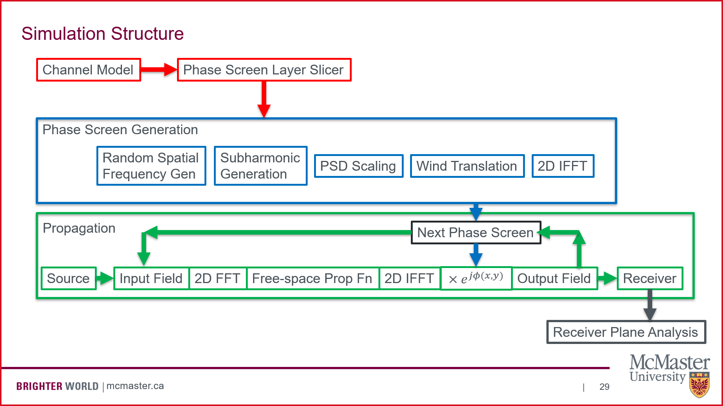
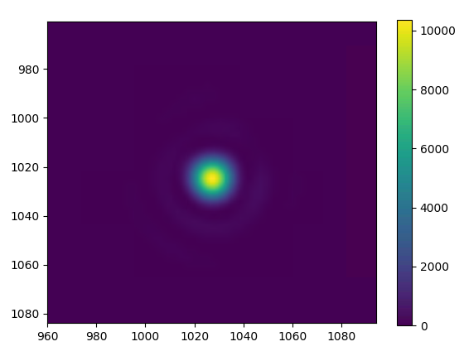
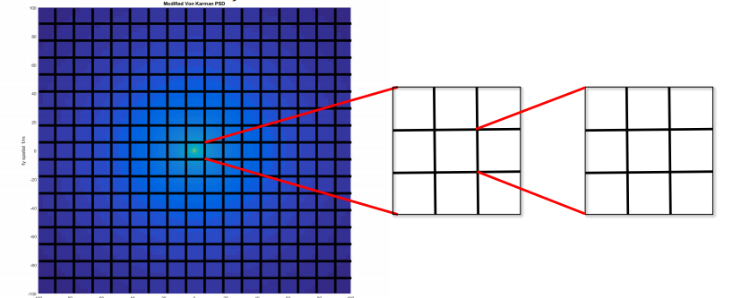
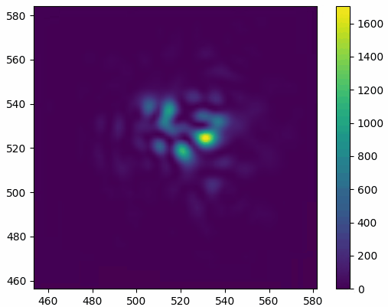
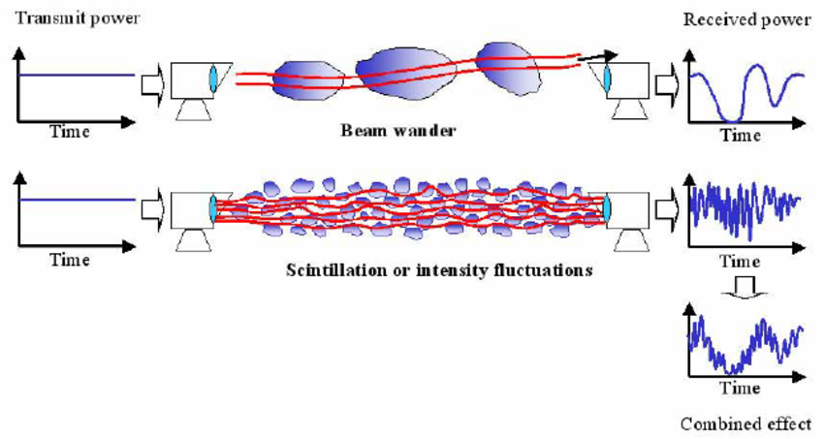
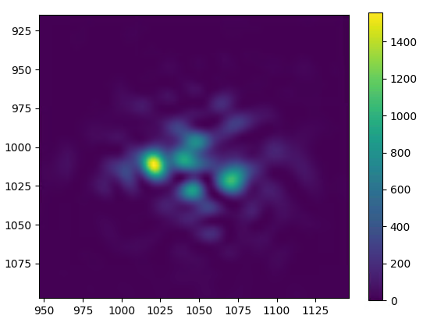
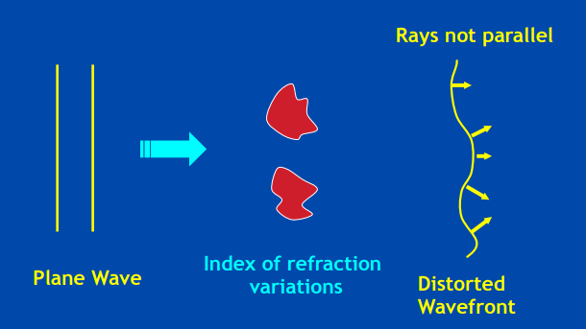
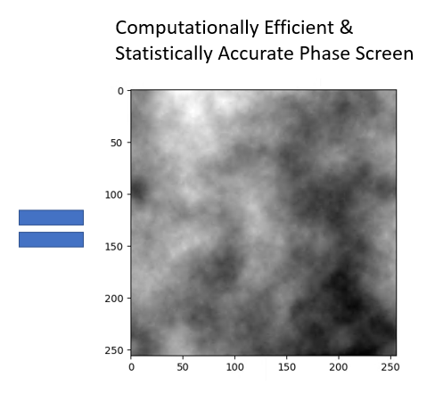
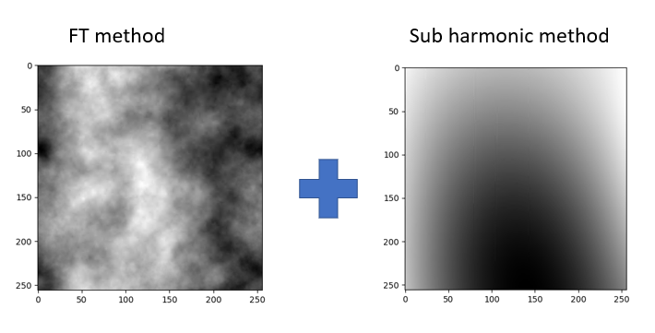
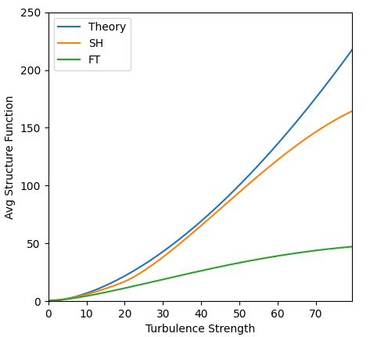
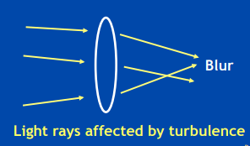
Atmospheric Turbulence Simulator for Optical Wave Propagation
Free-Space Optical Communication Algorithms Laboratory
Nicholas Mateus Undergrad Researcher, Supervised by Michael Taylor Ph.D., Overseen by Dr. Hranilovic Ph.D., P.Eng
Introduction & Objective
This research project’s intention is to utilize accurate turbulence models with modern hardware and software capabilities to architect an end-to-end optical turbulence propagation simulator. Key attention was brought to parallelization and processing speed using a GTX 3070 with 5GB VRAM, 8-core i7 10th Gen CPU, 64 GB RAM.
Kolmogorov Theory of Turbulence
Turbulence is assumed to be: incompressible, homogenous, isotropic, stationary in time Inertial Range (L₀: 100 m, l₀: 1 mm): scale in which turbulent eddies cascade down and dissipate Important parameters: C_{n}² – Refractive index structure parameter r₀ – coherence diameter D/r₀ – Aperture/coherence diameter -> measure of turbulence severity
Phase Screen Generation
Fourier Transform Method: (Noise) x (Refr. Index PSD) Subharmonic Method: Better low frequency sampling Final Phase Screen: Efficient and accurate
Temporal Phase Screen Evolution
Turbulence affected by wind (Taylor’s Frozen Flow Model), and chaotic evolution over time (Autoregressive Method)
Wave Propagation
Performance
Hardware | Optimizations? | Phase Screens (2048 x 2048) | Time
CPU | No | 100 | > 60s
GTX 3070 | No | 100 | 15s
GTX 3070 | Yes | 100 | 1.5s
GTX 3070 | No | 1,000 | > 60s
GTX 3070 | Yes | 1,000 | 7s
What is Atmospheric Turbulence?
Chaotic air flow affected by wind, temperature, altitude, etc Causes random fluctuations in the atmosphere’s refractive index – light bends when crossing boundaries between mediums with different refractive indices! Resulting in beam wander and scintillation
Research Emphasis
Specific effort was made to make the simulation: Fast - using a GTX 3070 with optimization techniques such as parallelization and memoization, High phase screen resolution (up to 4096 x 4096 – previous methods often only use 256 x 256) Simulation written using Python and Tensorflow
Simulation Architecture
Results – Focused Beam at Output Plane
Temporal Evolution of Distorted Wavefront
No Turbulence
How is Atmospheric Turbulence Simulated?
Optical wave propagation through atmospheric turbulence creates distorted wavefronts This behavior is identical to adding random phase adjustments to the input wavefront – phase screens!
References
J. D. Schmidt, Numerical simulation of optical wave propagation with examples in MATLAB. Bellingham, WA: SPIE, 2010. L. C. Andrews and R. L. Phillips, Laser beam propagation through random media. Bellingham: SPIE, 2005. A. M. Vorontsov, P. V. Paramonov, M. T. Valley & M. A. Vorontsov (2008) Generation of infinitely long phase screens for modeling of optical wave propagation in atmospheric turbulence, Waves in Random and Complex Media.
Mild Turbulence
Theory Comparison
Special Thanks
Funded through the “The Lakhani Family Experiential Learning and Discovery Fund - Engineering Research Experience Award” Support provided from the OSC and FOCAL research groups
Simulation Details
11 phase screens (2048 x 2048) 20km propagation 60 frames (ie: full simulated propagations) 30 seconds to generate – still room for more parallelization
Nicholas Mateus ECE Undergrad
Email: mateusn@mcmaster.ca
McMaster University, Department of ECE

